Slide 1
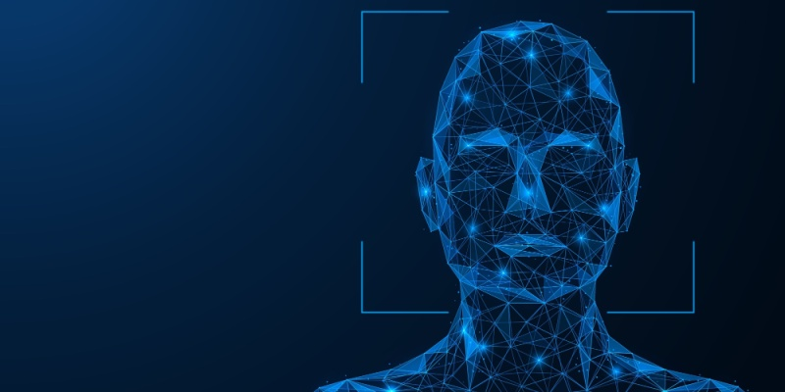
FACE
DETECTION

Slide 2
MADE BY :
GAMAL RAGAB
AHMED ATEF
AHMED SEYAM
AHMED HUSSEIN
HAZEM WAEL
EHAB ABD-ELRHMAN
EL-HUSSEINY HAMADA
HOSSAM HASSAN

Slide 3











THE STEPS OF THE PROJECT

Slide 4
Project Definition
Identifying and locating human faces in a digital Face detection image. Unlike face recognition, the goal here is not to identify who the person is, but simply to determine if a face exists and where it is located, and the project objective is to develop a MATLAB program that performs face detection without relying on any high-level built-in functions.

Slide 5
Project Definition
Identifying and locating human faces in a digital Face detection image. Unlike face recognition, the goal here is not to identify who the person is, but simply to determine if a face exists and where it is located, and the project objective is to develop a MATLAB program that performs face detection without relying on any high-level built-in functions.

Slide 6
Why not use built-in functions?
To gain a deeper understanding of:
How image processing works internally.
How face detection algorithms work conceptually.
How to control data manually using low-level operations.

Slide 7
Why not use built-in functions?
To gain a deeper understanding of:
How image processing works internally.
How face detection algorithms work conceptually.
How to control data manually using low-level operations.

Slide 8
Algorithm and its mathematical foundation
Convert RGB to YCbCr for better skin tone filtering
Threshold Cb and Cr to create a skin mask
Limit region to upper image (likely face area)
Clean mask using morphological operations
Extract regions and filter by shape (eccentricity)
Inside each region: check for 2 eyes and 1 nose using intensity filters
If found, draw a bounding box ( Face Detected )

Slide 9
Algorithm and its mathematical foundation
Convert RGB to YCbCr for better skin tone filtering
Threshold Cb and Cr to create a skin mask
Limit region to upper image (likely face area)
Clean mask using morphological operations
Extract regions and filter by shape (eccentricity)
Inside each region: check for 2 eyes and 1 nose using intensity filters
If found, draw a bounding box ( Face Detected )

Slide 10
Mathematical implementation in MATLAB

Slide 11
Image Normalizing:
Normalize the input image to a fixed size 300*300 for faster processing using the resize function:
img = imread("Path");
img = imresize(img, [300 300]);
2. YCbCr Transformation:
transform the image to YCbCr color space and extracting the chroma channels (Cb and Cr) to detect skin-colored pixels.
imginycbcr = rgb2ycbcr(img);
Cb = imginycbcr(:,:,2);
Cr = imginycbcr(:,:,3);

Slide 12
3. Making a skin color mask:
Thresholds the chroma channels to identify skin colored pixels.
skinrangemask = (Cb >= 77 & Cb <= 130) & (Cr >= 140 & Cr <= 160);
4. Focusing on the upper 0.75 of the image and combining both filters:
[rows, cols] = size(skinrangemask);
upperpartmask = false(size(skinrangemask upperpartmask(1:round(rows*0.75), :) = true;
skininupperpart = skinrangemask & upperpartmask;

Slide 13
5. Cleaning the image:
Filling holes in the upper part of the image:
skininupperpart = imfill(skininupperpart, 'holes'); and removing small regions (noise) with less than than 200 pixels:
skininupperpart = bwareaopen(skininupperpart, 200);
6. Region Extraction:
Which analyzes each connected component and measure their shape using eccentricity (how oval or circular the shape is) and then gets bounding boxes for drawing rectangles later:
result = regionprops(skininupperpart, 'BoundingBox', 'Eccentricity');

Slide 14
7. Face filtering test :
Keeps regions with eccentricity < 0.9 (nearly oval) this filters out the long or skinny regions:
for i = 1:length(result) e = result(i).Eccentricity; if e < 0.9
8. Eyes and nose tests:
Crops and gray scales the candidates first then tests for eyes (dark regions<60) and tests for nose (mid gray regions (80-120)) then cleans up noise .

Slide 15
9. Face confirmation and rectangle drawing :
Only accepts a region if at least there is 2 eyes and 1 nose and then draws a rectangle on the image if it passes through the tests: if length(eyesresult) >= 2 && ~isempty(noseresult) rectangle(app.UIAxes, 'Position', rect, 'EdgeColor', 'cyan','LineWidth', 3); face = 1;
end
10. Display the results in the title :
if face==1 title('Face Detected’);
else title('No Face Detected’);
end

Slide 16
Problem faced and solutions

Slide 17
Lighting Variation
Skin color or facial shades can vary significantly under different lighting conditions, leading to inaccurate color detection. Solution is to convert to a more stable color space like ”YCbCr” or “HSV”.
2. Background Interference with Skin Color
If the background contains skin-like colors, many false positives may occur. The solution is to limit the detection to the upper region and eccentricity filtering and reduce noise.
3. Variations in Skin Colors and Types
The thresholds used (Cb and Cr) Uses a wider range of thresholds to cover diverse skin tones.

Slide 18
4. False Positives Due to Shape Similarity
Some regions may resemble eyes or a mouth but are not actual facial features. Check the “Bounding Box” aspect ratio (width-to-height) and eccentricity for logical consistency.
5. Performance and Speed
Processing large images or multiple images may slow down the system. The solution is to reduce image size (resizing to 300*300) and to use grayscale operations instead of RGB.

Slide 19
Testing and results

Slide 20
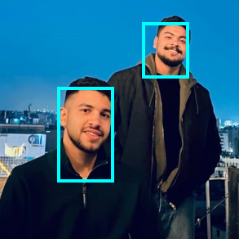
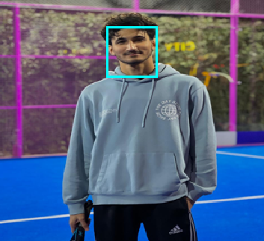
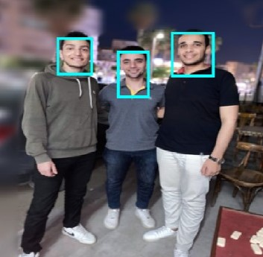
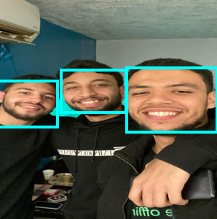
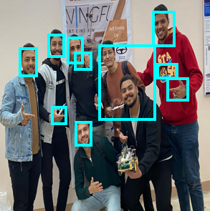

Slide 21
ANY QUESTIONS ?

